Slide 1
Data Bootcamp Data Analysis Presentation
Semarri Woollery
Black Disruptor Data Analytics Bootcamp (WMCA -
January 2022 Cohort).

Slide 2


Me time
I currently am on maternity leave working for an estate agent, booking in surveyors to complete house purchases.
Prior to that I have mostly worked in events and event management jobs.
My current education level is Masters in sport management. In which I wish to continue to work within events but at more senior level.

Slide 3




What did I learn during the course ?

Slide 4

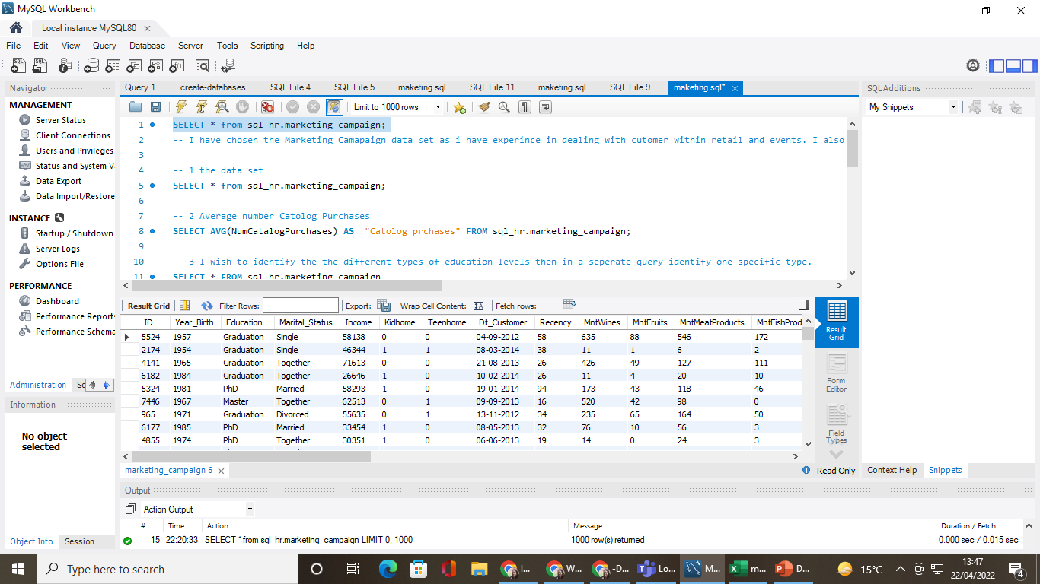


Slide 5
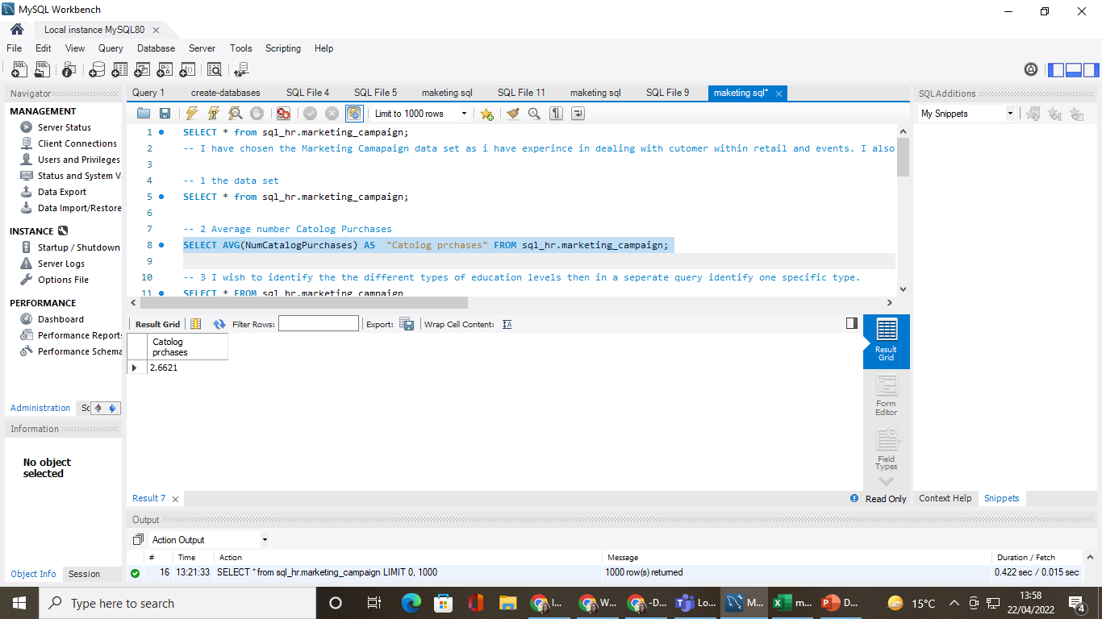

Slide 6
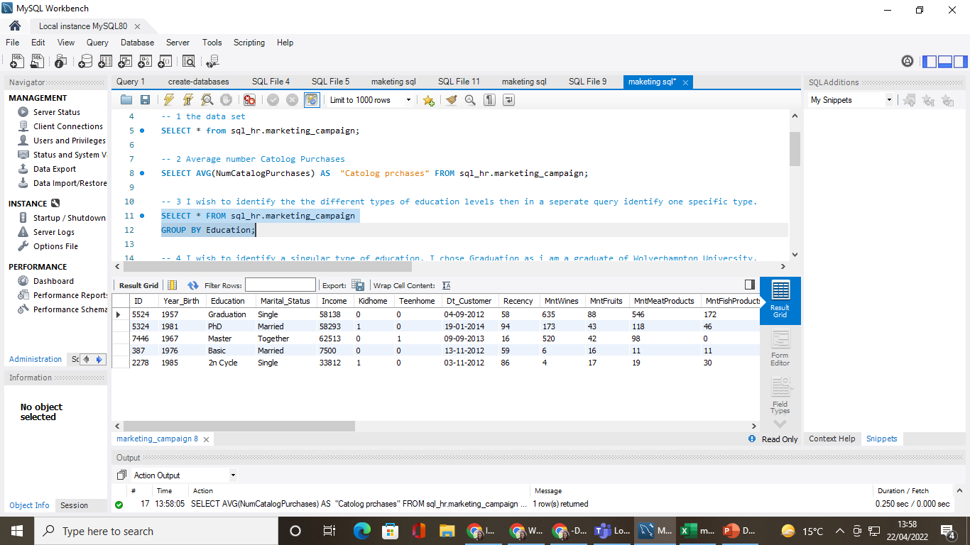

Slide 7
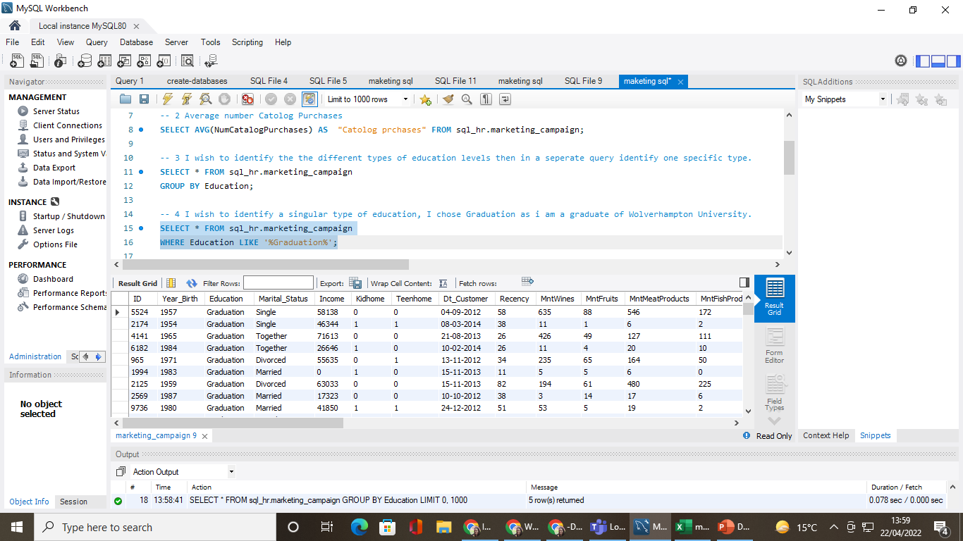

Slide 8
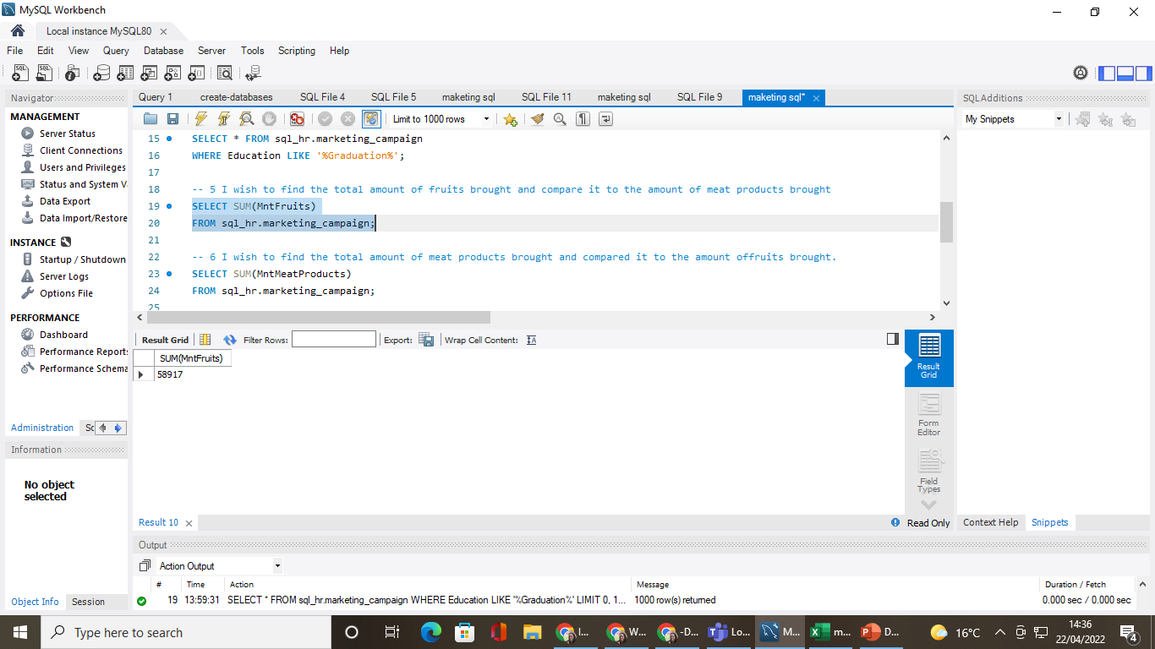

Slide 10


Slide 11
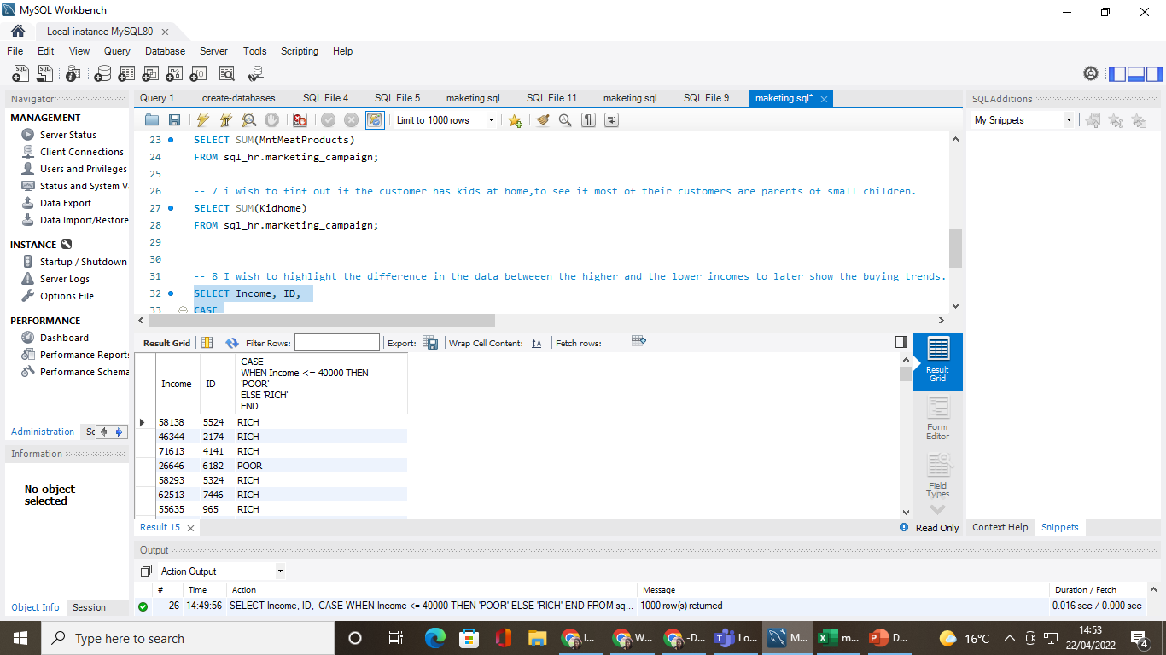

Slide 12
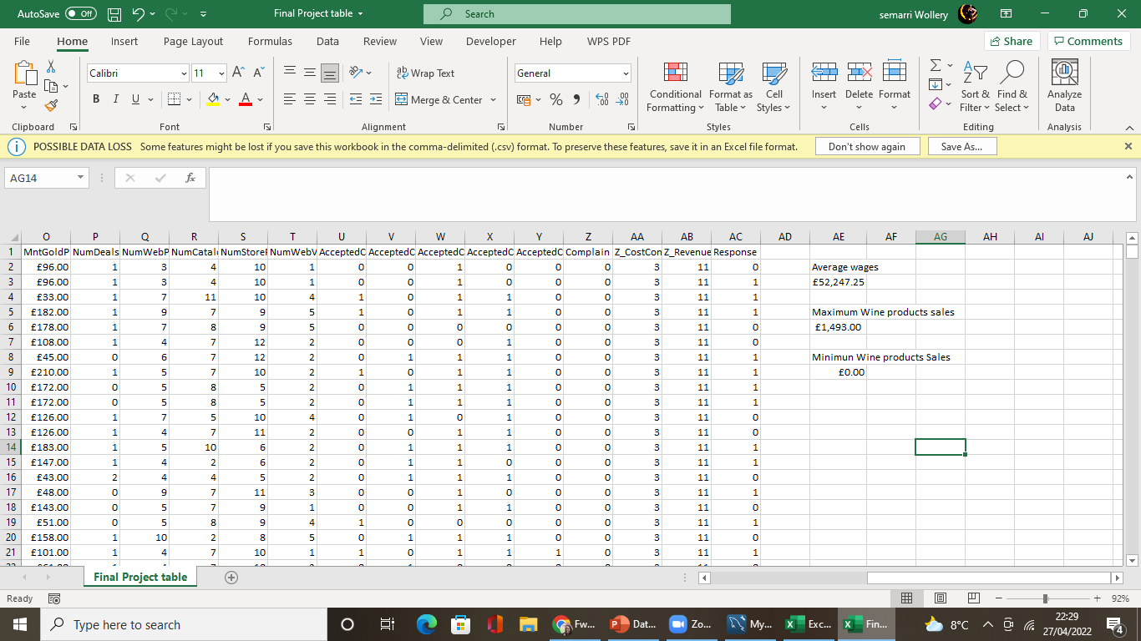
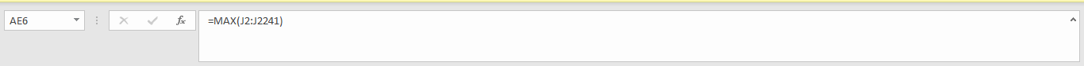
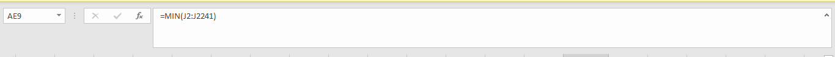
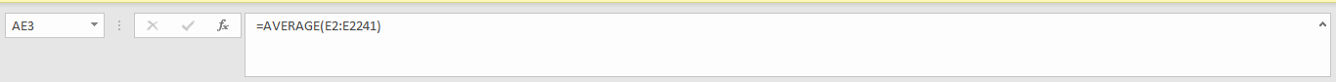

Slide 13
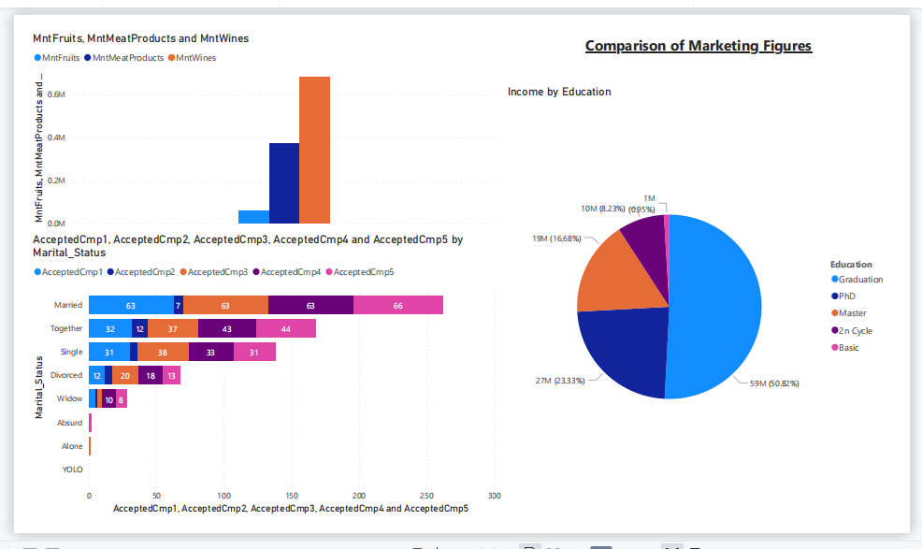

Slide 14
Any Questions ?

